Slide 1

15CSE301 Computer Organization and Architecture
Lab 2
Deeper understanding of iverilog
Dr Ganesh Neelakanta Iyer
Associate Professor, Dept of Computer Science and Engg
Amrita Vishwa Vidyapeetham, Coimbatore

Slide 2
Hardware Description Language - Introduction
HDL is a language that describes the hardware of digital systems in a textual form.
It resembles a programming language, but is specifically oriented to describing hardware structures and behaviors.
The main difference with the traditional programming languages is HDL’s representation of extensive parallel operations whereas traditional ones represents mostly serial operations.
The most common use of a HDL is to provide an alternative to schematics

Slide 3
HDL – Introduction (2)
When a language is used for the above purpose (i.e. to provide an alternative to schematics), it is referred to as a structural description in which the language describes an interconnection of components.
Such a structural description can be used as input to logic simulation just as a schematic is used.
Models for each of the primitive components are required.
If an HDL is used, then these models can also be written in the HDL providing a more uniform, portable representation for simulation input.

Slide 4
HDL – Introduction (3)
HDL can be used to represent logic diagrams, Boolean expressions, and other more complex digital circuits.
Thus, in top down design, a very high-level description of a entire system can be precisely specified using an HDL.
This high-level description can then be refined and partitioned into lower-level descriptions as a part of the design process.

Slide 5
HDL – Introduction (4)
As a documentation language, HDL is used to represent and document digital systems in a form that can be read by both humans and computers and is suitable as an exchange language between designers.
The language content can be stored and retrieved easily and processed by computer software in an efficient manner.
There are two applications of HDL processing: Simulation and Synthesis

Slide 6
Logic Simulation
A simulator interprets the HDL description and produces a readable output, such as a timing diagram, that predicts how the hardware will behave before its is actually fabricated.
Simulation allows the detection of functional errors in a design without having to physically create the circuit.

Slide 7
Logic Simulation (2)
The stimulus that tests the functionality of the design is called a test bench.
To simulate a digital system
Design is first described in HDL
Verified by simulating the design and checking it with a test bench which is also written in HDL.

Slide 8
Logic Simulation
Logic simulation is a fast, accurate method of analyzing a circuit to see its waveforms

Slide 9
Types of HDL
There are two standard HDL’s that are supported by IEEE.
VHDL (Very-High-Speed Integrated Circuits Hardware Description Language) - Sometimes referred to as VHSIC HDL, this was developed from an initiative by US. Dept. of Defense.
Verilog HDL – developed by Cadence Data systems and later transferred to a consortium called Open Verilog International (OVI).

Slide 10
Verilog
Verilog HDL has a syntax that describes precisely the legal constructs that can be used in the language.
It uses about 100 keywords pre-defined, lowercase, identifiers that define the language constructs.
Example of keywords: module, endmodule, input, output wire, and, or, not , etc.,
Any text between two slashes (//) and the end of line is interpreted as a comment.
Blank spaces are ignored and names are case sensitive.

Slide 11
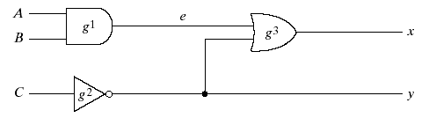
Verilog - Module
A module is the building block in Verilog.
It is declared by the keyword module and is always terminated by the keyword endmodule.
Each statement is terminated with a semicolon, but there is no semi-colon after endmodule.

Slide 12
Verilog – Module (2)
HDL Example
module smpl_circuit(A,B,C,x,y);
input A,B,C;
output x,y;
wire e;
and g1(e,A,B);
not g2(y,C);
or g3(x,e,y);
endmodule

Slide 13
Different coding styles
Behavioral or Algorithmic level
Data flow level
Gate or structural level
Switch level
Highest
Level of Abstraction
Lowest

Slide 14
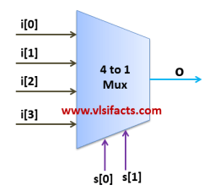
Lets see the differences between them with help of a 4:1 mux

Slide 15
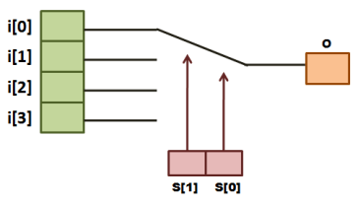
Behavioural or Algorithmic level
Highest level of abstraction
A module can be implemented in terms of the desired design algorithm without concern for the hardware implementation details
It specifies the circuit in terms of its expected behavior
It is the closest to a natural language description of the circuit functionality

Slide 16
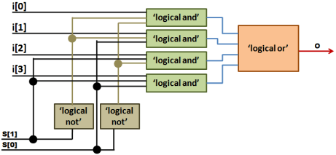
Data flow level
Module is designed by specifying the data flow
Looking towards this design, one can realize how data flows between hardware registers and how the data is processed in the design
This style is similar to logical equations. The specification is comprised of expressions made up of input signals and assigned to outputs.
In most cases, such an approach can be quite easily translated into a structure and then implemented.

Slide 17
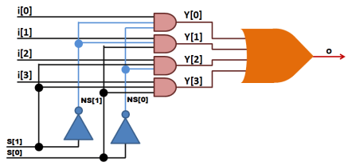
Gate level or Structural level
The module is implemented in terms of logic gates and interconnections between these gates
It resembles a schematic drawing with components connected with signals
A change in the value of any input signal of a component activates the component
A structural system representation is closer to the physical implementation than behavioral one but it is more involved because of large number of details
Since logic gate is most popular component, Verilog has a predefined set of logic gates known as primitives

Slide 18
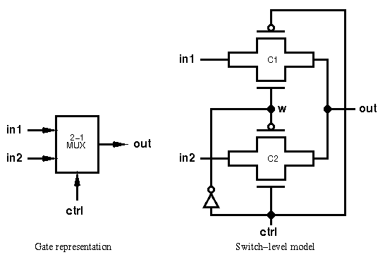
Switch level
This is the lowest level of abstraction provided by Verilog.
A module can be implemented in terms of transistors, switches, storage nodes, and the interconnections between them.
In Verilog HDL transistors are known as Switches that can either conduct or open
Design at this level requires knowledge of switch-level implementation details
Verilog supports design that can be represented in different modeling levels
Describing the design at different levels is known as Mixed-level Modeling
Simulating the design consisting of different modeling levels is known as Mixed-level Simulation

Slide 19
Lexical Tokens
Verilog language source text files are a stream of lexical tokens
E.g. Comments, identifiers, keywords etc
The basic lexical tokens used by the Verilog HDL are similar to those in C Programming Language
Verilog is case sensitive
All the key words are in lower case

Slide 20
Lexical Tokens
White space
White spaces can contain characters for spaces, tabs, new-lines and form feeds
These characters are ignored except when they serve to separate tokens
White space characters are Blank space, Tabs, Carriage returns, New line, and Form feeds
Comments
Single line comments begin with the token // and end with carriage return.
Ex.: //this is single line syntax
Multiline comments begins with the token /* and end with token */
Ex.: /* this is multiline Syntax*/

Slide 21
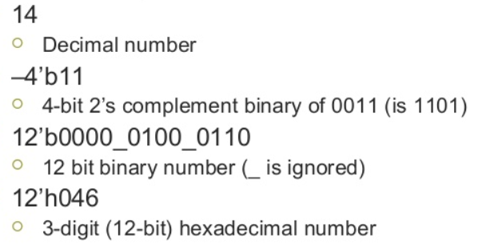
Lexical Tokens
Numbers
You can specify a number in binary, octal, decimal or hexadecimal format
Negative numbers are represented in 2’s compliment numbers.
Verilog allows integers, real numbers and signed & unsigned numbers.
The syntax is given by − <size> <radix> <value>
Size or unsized number can be defined in <Size> and <radix> defines whether it is binary, octal, hexadecimal or decimal
D or d for Decimal
H or h for Hexadecimal
B or b for Binary
O or o for Octal

Slide 22
Lexical Tokens
Identifiers
Identifier is the name used to define the object, such as a function, module or register
Identifiers should begin with an alphabetical characters or underscore characters. Ex. A_Z, a_z,_
Identifiers are a combination of alphabetic, numeric, underscore and $ characters
They can be up to 1024 characters long

Slide 23
Lexical Tokens
Operators
Operators are special characters used to put conditions or to operate the variables
There are one, two and sometimes three characters used to perform operations on variables.
Ex. >, +, ~, &! =.

Slide 24
Keywords
always | end | ifnone | or | rpmos | tranif1
and | endcase | initial | output | rtran | tri
assign | endmodule | inout | parameter | rtranif0 | tri0
begin | endfunction | input | pmos | rtranif1 | tri1
buf | endprimitive | integer | posedge | scalared | triand
bufif0 | endspecify | join | primitive | small | trior
bufif1 | endtable | large | pull0 | specify | trireg
case | endtask | macromodule | pull1 | specparam | vectored
casex | event | medium | pullup | strong0 | wait
casez | for | module | pulldown | strong1 | wand
cmos | force | nand | rcmos | supply0 | weak0
deassign | forever | negedge | real | supply1 | weak1
default | for | nmos | realtime | table | while
defparam | function | nor | reg | task | wire
disable | highz0 | not | release | time | wor
edge | highz1 | notif0 | repeat | tran | xnor
else | if | notif1 | rnmos | tranif0 | xor

Slide 25
15CSE381 – COA Lab
Icarus Verilog is a free compiler implementation for the IEEE-1364 Verilog hardware description language
http://bleyer.org/icarus/
We will use this to simulate hardware design in our lab
/* A simple and gate
File: 1_and.v */
module andgate (a, b, y);
input a, b;
output y;
// using data flow abstraction
assign y = a & b;
//using gate level abstraction
//and a1(y,a,b);
//run either gate level or data flow level code
endmodule

Slide 26
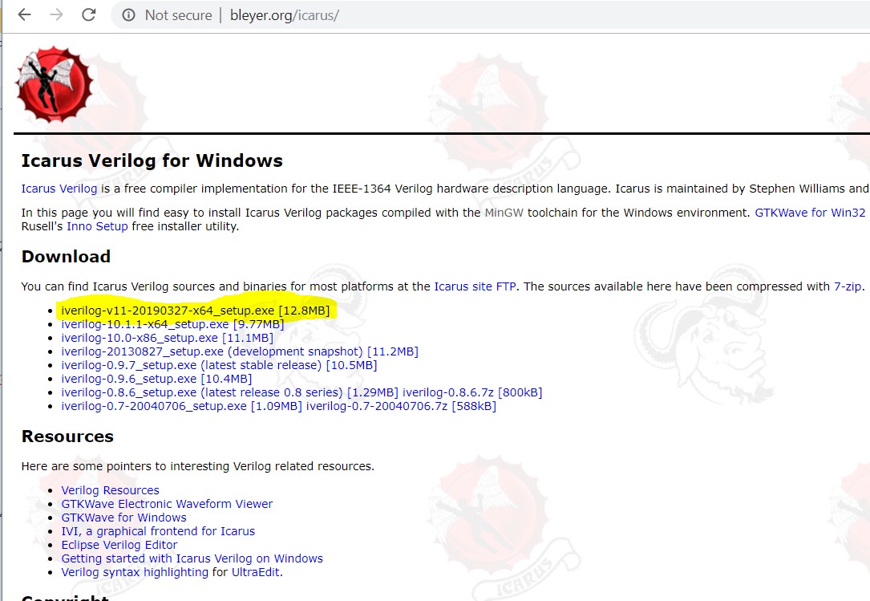
iverilog

Slide 27
Procedure
Complete the installation
Open the folder mentioned during the installation
In my case, it was C:\iverilog
You can write your first hello.v program in the bin folder under C:\iverilog

Slide 28
hello.v
module hello;
initial
begin
$display("Hello, World");
$finish ;
end
endmodule

Slide 29
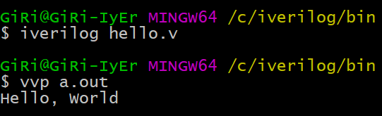
Running Verilog code
Open command prompt under C:\iverilog\bin
compile this program with the command:
iverilog -o hello hello.v
The results of this compile are placed into the file "hello", because the "-o" flag tells the compiler where to place the compiled result. Next, execute the compiled program like so:
vvp hello
Hello, World

Slide 30
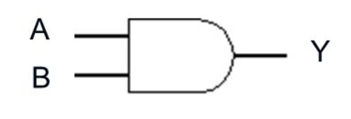
Lets start with an AND dgate
A | B | Y
0 | 0 | 0
0 | 1 | 0
1 | 0 | 0
1 | 1 | 1
http://electrosofts.com/verilog/introduction.html

Slide 31
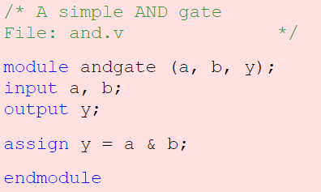
AND Gate Verilog code Open a file and.v and write this

Slide 32
Lets understand the code
In verilog, one circuit is represented by set of "modules“
We can consider a module as a black box
With this assumption, if you draw a block diagram of the circuit with a set of signals connection each other, that is called top level design
Then go on writing modules for each black box, then design that black box with in the same way
This is how we are designing a circuit
You will understand this concept after studying some examples
A module may be one gate, one flip-flop, one register, one ALU one controller or one SOC
Go back to the example. Here, module is keyword, andgate is the name given to the module in this examples and a, b and y are the ports or connections to the module. Every modules and with the keyword endmodule

Slide 33
Lets understand the code
In the beginning of a module, we have to declare all ports as input output or inout. By default, ports will have one pin or one bit.
Using 'assign' statement, we connected inputs and outputs via AND gate
A will be ANDed with B and will be connected to Y
Here, we are not going to store the values, and hence we did not declare any registers

Slide 34
How Are Simulators Used?
Testbench generates stimulus and checks response
Coupled to model of the system
Pair is run simultaneously
Testbench
System Model
Stimulus
Response
Result checker

Slide 35
Writing Testbenches
Inputs to device under test
module test;
reg a, b, sel;
mux m(y, a, b, sel);
initial begin
$monitor($time,, “a = %b b=%b sel=%b y=%b”,
a, b, sel, y);
a = 0; b= 0; sel = 0;
#10 a = 1;
#10 sel = 1;
#10 b = 1;
end
Device under test
$monitor is a built-in event driven “printf”
Stimulus generated by sequence of assignments and delays

Slide 36
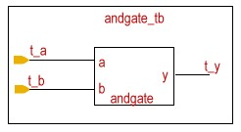
Testbench
Next we will write a testbench to test the gate that we have created
Testbench is another verilog code that creates a circuit involving the circuit to be tested
This code will send different inputs to the code under test and get the output and displays to check the accuracy.

Slide 37
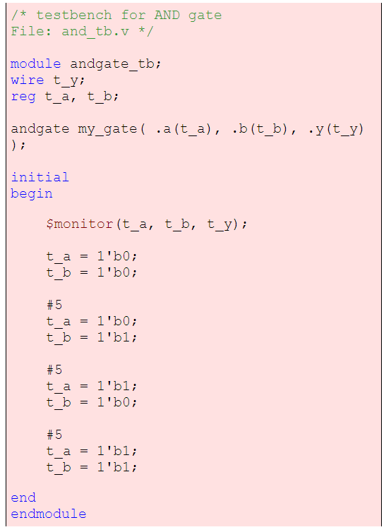
Testbench Write this in a new file and_tb.v
Here we have created another module andgate_tb which will include the module andgate
We have to give values to input, so we need to store or latch the input data
So, t_a and t_b are declared as reg and t_y as wire to get the output value from the gate
Now, we create an instance of andgate.
i.e., we are placing the and gate that we have created previously inside this module. We can use two different notations to connect the ports

Slide 38
We can write
andgate my_gate(t_a, t_b, t_y);
This is called instanciating by order.
Here, all the ports should be in the order as we declared in the module definition.
If we write as given in the example, we can change the order. That is,
andgate my_gate( .a(t_a), .b(t_b), .y(t_y) );
is equal to
andgate my_gate( .b(t_b), .y(t_y), .a(t_a) );
This is called instanciation by name
Like this, we can use any number of instances of same module in a design.

Slide 39
'a' in the andgate will be connected to t_a in the andgate_tb and so on
If some of the statements in our code is to be executed only in the beginning of the execution, we can write them using initial block
initial block executes only once and starts at time=0
Your program may have any number of initial blocks
initial block begins with begin and ends with end
Inside an initial block, statements will execute sequentially

Slide 40
$monitor is a system task used to display the values in variable whenever value of one of its arguments changes
After that we will assign different values to t_a and t_b
Here 1'b0 indicates a low signal and 1'b1 represents a high signal
Meaning of this notation is, a 1 bit variable expressed in binary as 1
Integer | Meaning | Stored as
5'b00101 | 5 bit binary 00101 | 00101
8'b0 | 8 bit binary 00000000 | 00000000
8'b101 | 8 bit binary 00000101 | 00000101
8'd5 | 8 bit decimal 5 | 00000101
8'h9f | 8 bit hex 9f | 10011111
3'd1 | 3 bit decimal 1 | 001
4'bz | 3 bit decimal z | zzzz
4'bx1 | binary | xxx1
5'b11z | binary | 0011z
15 | 32 bit decimal 15 | 0....01111(32 bits)
'o5 | 32 bit octal 5 | 0....00101(32 bits)
1: Active high bit
0: Active low bit
z: high impedance
x: Uncertain/ Don't care
If not mentioned, length is 32 bit and data type is integer by default.
If value is larger than the length, left most bits will be truncated
If value is smaller,
0's are filled to the left if left most bit is 0 or 1
'z' are filled if left most bit is z
'x' are filled if left most bit is x

Slide 41
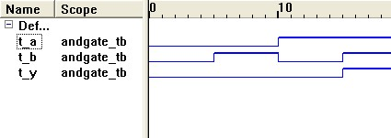
#5 indicates a delay of 5ns
To observe the changes in the output waveform, we need to include this delay
If we observe the output, we can notice that input changes in the intervals of 5ns and we will get corresponding ANDed output in t_y

Slide 42
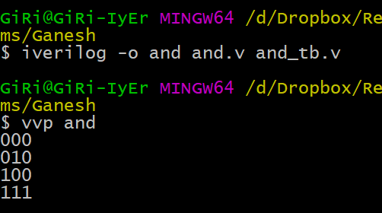
Running it
Command to compile
iverilog –o and and.v and_tb.v
Command to run
vvp and

Slide 43
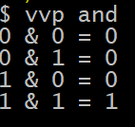
Modify
Can you modify the testbench to get the output as follows?
Modify monitor line as follows
$monitor("%b & %b = %b",t_a, t_b, t_y);

Slide 44
Try different options
What happens when I remove the delay values
Write code and test bench for OR, NOT, XOR, XNOR, NAND, NOR

Slide 45
Office Hours
Monday 1120-1210 @ My office

